Slide 1
Welcome to Parent Information Night!
Walabi and Birrahlee K-1

Slide 2
Please stay in close contact!
justine.doorn-mccormack@det.nsw.edu.au
melinda.dorin@det.nsw.edu.au
School phone: 42360173
All permission notes will be done through the CareMonkey app.
We are usually able to see you before or after school – just pop in!
Evidence shows students are more successful when parents are more involved.

Slide 3
Class Dojo
Whole-school use of this app for consistency in messaging across the school.
Sign-in code for all parents.

Slide 4
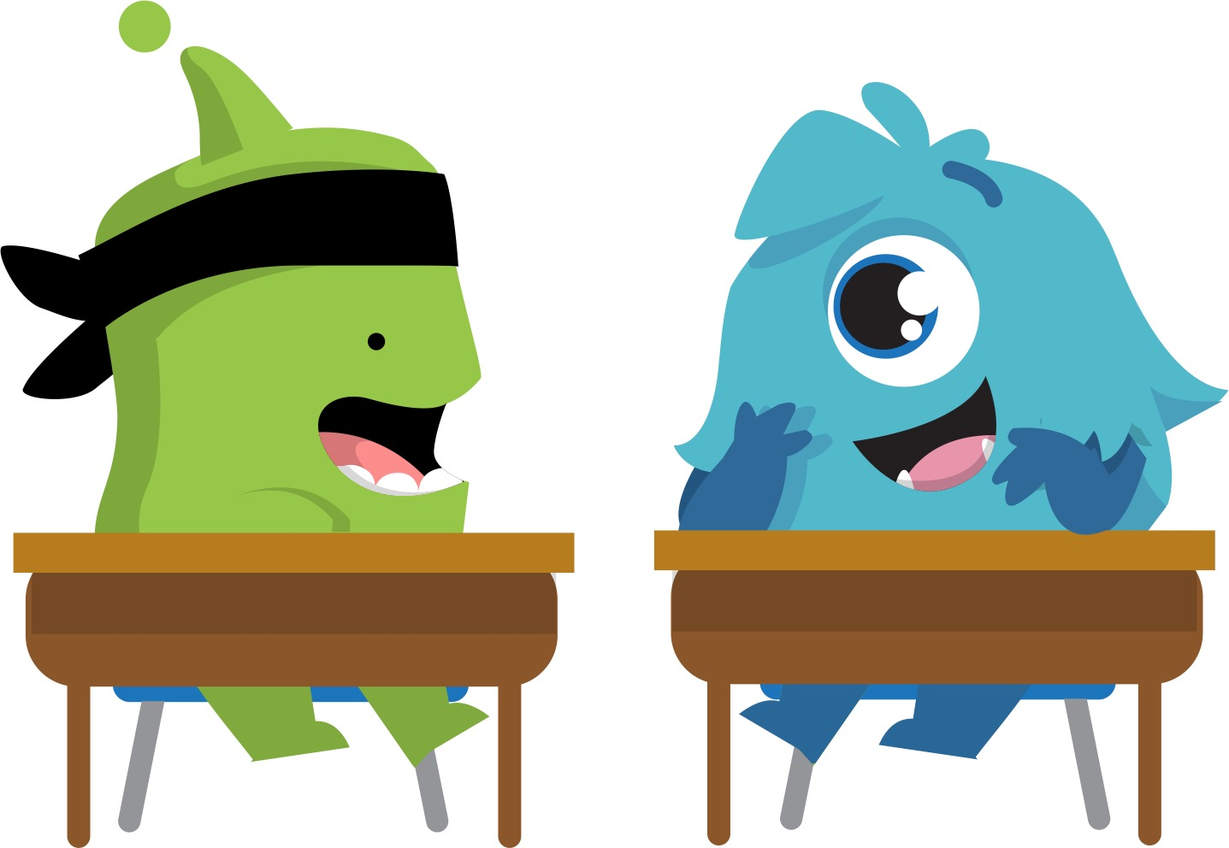
This year, we’re using ClassDojo to build our classroom community
We’ll build a positive culture where students are engaged, encouraged, and love learning!
All parents are part of our classroom community, seeing what we’re learning every day.

Slide 5

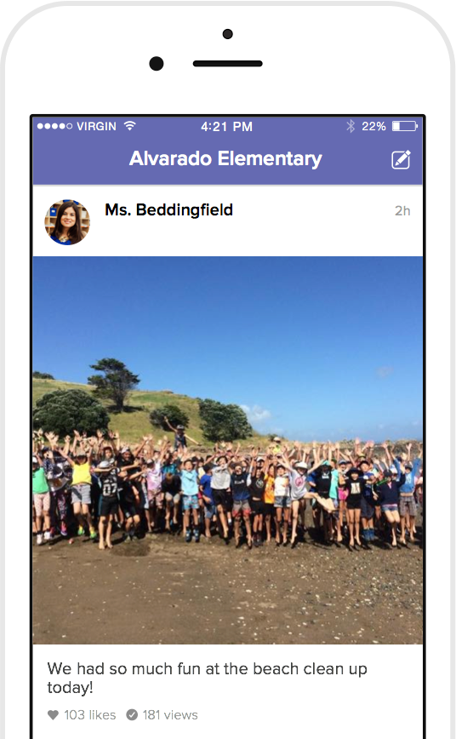
How we’ll use ClassDojo
As a teacher, I will:
Post announcements and updates regularly on Class Story
Share photos and videos of our classroom activities
Send private messages to keep you in the loop!
Students will:
Share classwork on their own digital portfolio
Only family members will be able to view their work

Slide 6
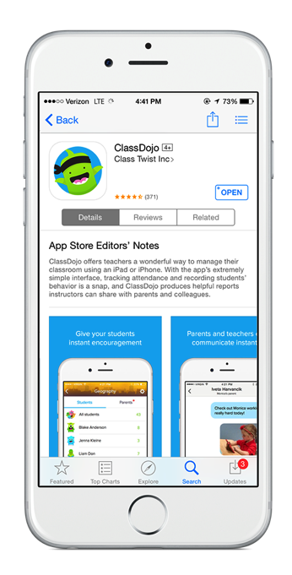
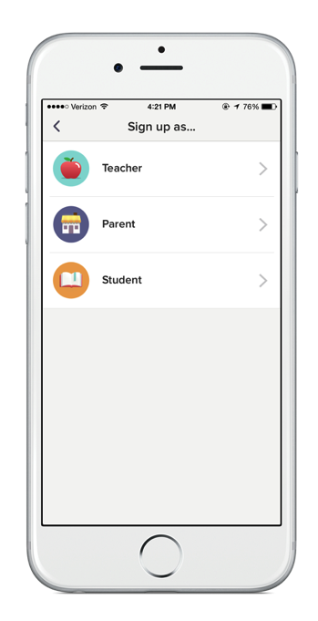
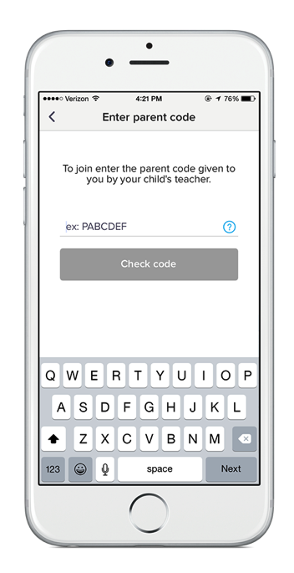
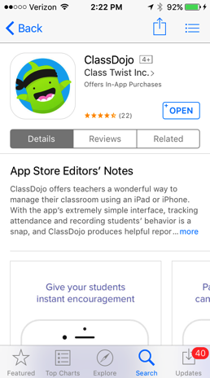
Let’s get connected!
3 easy steps
1. Download the app
iOS, Android, Kindle Fire
2. Sign up as a parent
3. Enter your code!

Slide 7
Teachers can use the app and toggle between ‘teacher’ and ‘parent.’
You will also be asked to join Mrs Xuereb’s ‘class,’ for Library and RFF.
Please enable notifications for the app so you know when we send you a message.
This will be the school’s primary method of communication this year – there will be whole school messages too.
Save your login details so that your child can change his/her monster at home.

Slide 8
School Supplies!
Please make sure your child has in the classroom all the things that we requested.
Extra sets of supply lists are available if you need one.

Slide 9
Homework!
Nightly reading
Year 1s will start next week and Kinders the week after. Students should bring in their reading folder/homework folder every day. (As you move up the levels you will find you need a few days to finish a book.)
Nightly reading – at least four nights per week – is very important. More is even better! (Or read in the morning)
Reading log is checked daily/weekly.

Slide 10
Reading level targets:
Kindergarten: The target for Kindergarten students is to be at Level 4 or 5 at the end of Semester One and Level 9 by the end of the year.
Year One: Level 14 or 15 by the end of Semester One and Level 17 by the end of the year. The focus in Year One for most students is on comprehension -- talking about books and beginning to read widely and find books you are interested in, particularly once the students is in the 20s.

Slide 11
Weekly Homework
Year 1s: Homework book will go home on Mondays and is due back on Fridays, starting in Week 6, when our spelling program starts. Please help your child to develop his/her sense of responsibility with this.
Kinder students will have weekly homework in Semester Two.

Slide 12
Mathletics
Cost approx $20 excellent deal
Homework – assigned tasks each week
Allows teacher to set appropriate work; immediate feedback for student
“Help button”
Appropriate for parent to sit with child if needed

Slide 13
Theme work and Science
Term 1: Interpersonal Relationships(PDH) – how to communicate your needs; talking about friends and family and bullying prevention.
Science: K: Weather in my World, Yr 1: Look, Listen.
  Term 2 History K: Personal and Family History
  Year 1: the Past in the Present
  Science: K: What’s It made of? Yr 1: Waterworks

Slide 14
Theme work/Science cont.
Term 3: Geography: K: People Live in Places, Yr 1: Features of Places
Excursion to Minnamurra Rainforest
Science: K: On the Move, Yr 1: Spot the Difference (how materials can be changed)
  Term 4: PDH: Child Protection and Safe Living
  Science: K: Staying Alive, Yr 1: Watch it Grow

Slide 15
Dance Festival for Year 1 students:
Every second year, our Year 1 and 2 students participate in South Coast Public Schools’ Dance Festival.
This year Mrs Martin will be teaching the dance group.
The dance act can have up to 30 dancers. Mrs Martin will send out an Expression of Interest to Year 1 parents to see which students are interested, as we have more than 30 students in Stage 1. Students who choose not to do dance will do other Creative Arts activities.
Dance Festival will be at the IPAC in Wollongong in the week of Tuesday 29 May through to Saturday 2 June 2018 (late Term 2).

Slide 16
Weekly timetable:
Monday: homework books go home, lunch orders in
Tuesday: lunch orders, Science for Birrahlee
Wednesday: Library (bring your library bag)
Thurs. Gymnastics, Scripture/non-scripture/Ethics 2:00-2:40; Science for Walabi
school assembly 11:55, homework books due back
Students may wear joggers on PE day. Walabi – Monday.Birrahlee --

Slide 17
Students will be taking their shoes off for gymnastics, so it will be very helpful if you child can take off his/her shoes and put them back on again, independently.
(Of course, we will help, but the ratio of teacher to students is 1:20 so it can be slow going!)

Slide 18
Student Welfare
3 reminders – school policy
1st and 2nd reminder– verbal / class time out
3rd reminder – time out on verandah at 2nd half lunch
If further issues, student will be referred to Mr Speirs
Individual needs taken into account

Slide 19
Premier’s Reading Challenge
will be run through the library and Mrs Xuereb. You can log your books at home online or keep track on paper. We will also add the books that we read together in class, so all Birrahlee and Walabi students should receive their PRC award.
Students read 30 PRC books, March to August.
Have your child check out PRC books each week in library; March to August
Visit https://products.schools.nsw.edu.au/prc/home.html

Slide 20
Crunch&Sip
Fresh fruit and vegetables
Sip on water
It would be very helpful if it is in a separate container and they don’t have to bring their lunch box in to the classroom

Slide 21
Awards
Please keep safely at home e.g. in a folder or display book
Send in to office at 5 for Bronze Award; 10 for Silver; 20 for Gold. Then they can attend Gold Day at the end of the year. Awarded these special awards at Friday assemblies.
It is very important to do your home reading and write it in your reading log in order to get your homework award. You need to do both home reading and weekly homework sheet to get your homework awards (once you have both).
Be extra aware if your child has two homes. Keeping track of awards is hard!

Slide 22
Parent helpers:
Please sign up if you are able to help during morning literacy sessions, on the clipboard. Parent helpers enable the teacher to focus on excellent instruction in small reading groups.
Sign in at the office. You need your Working With Children Clearance for volunteers.
Come and see us before school if you can, the first time you come in, so we can explain how you will help.
Parent helpers must respect each student’s privacy rights.
A great opportunity to see what’s happening in the classroom!

Slide 23
HOW2Learn
Focus on how we can help our own brains – growth mindset. No such thing as a fixed IQ. Practice is what helps us improve at something
Learning Pit – learning should be challenging
The power of ‘yet.’
Later in the year: Learning Habits.

Slide 24
Thank you for attending!
Please take the handout which has all the information on it.
Supply list - if needed
Please sign up if you would like to be a parent helper
Future evening event – helping your child with reading. Does this time suit the best?

